Slide 1
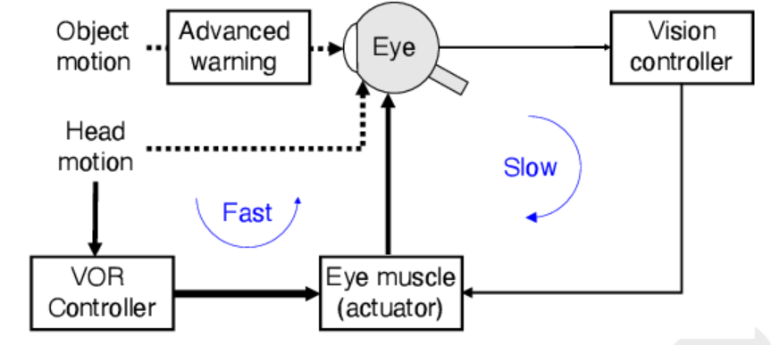
Robust and efficient control using temporally layered architecture
We present a temporally adaptive Reinforcement learning architecture.
The architecture is temporally layered, inspired from biological control systems.
This allows the system to be:
efficient: allowing control with fewer selected actions.
Robust: allowing it to handle perturbations in the environment that cannot be handled by the slower network
Life-long learner: Additional layers can be added for changes in the environments or agent. Without having to retrain the agent entirely.
Picture taken from:
Nakahira, Yorie et al. “Diversity-enabled sweet spots in layered architectures and speed–accuracy trade-offs in sensorimotor control.” Proceedings of the National Academy of Sciences 118 (2021): n. pag.

Slide 2
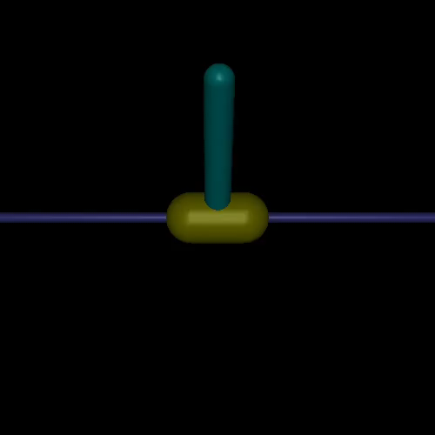
Biologically inspired architecture
Slow controller
Fast Controller
Slow
Fast
Action
PLANNED SLOW ACTION

Slide 3
Training and Inference
Train slow network in the normal environment
Add a faster network layer and train it either in the normal environment or a modified environment with added perturbations.
For the faster network: The possible maximum action values = 2 x max_values
The action performed in the environment = min(slow action + fast action, max_value)
After training: Gate the faster network so that it only activates above a certain threshold.

Slide 4
Results
Environment | TLA (Temporally layered architecture, ours) |  | TD3
 | Performance | Actions picked | Performance | Actions picked
InvertedPendulum-v2 | 1000 | 1000 | 1000 | 1000
InvertedPendulum-v2 + perturbations | 107 | 3,692 (70%) | 101.9 | 5095
Hopper-v2
Hopper-v2 + perturbations | 636.2 | 90% | 303.25 | 100%

Slide 5
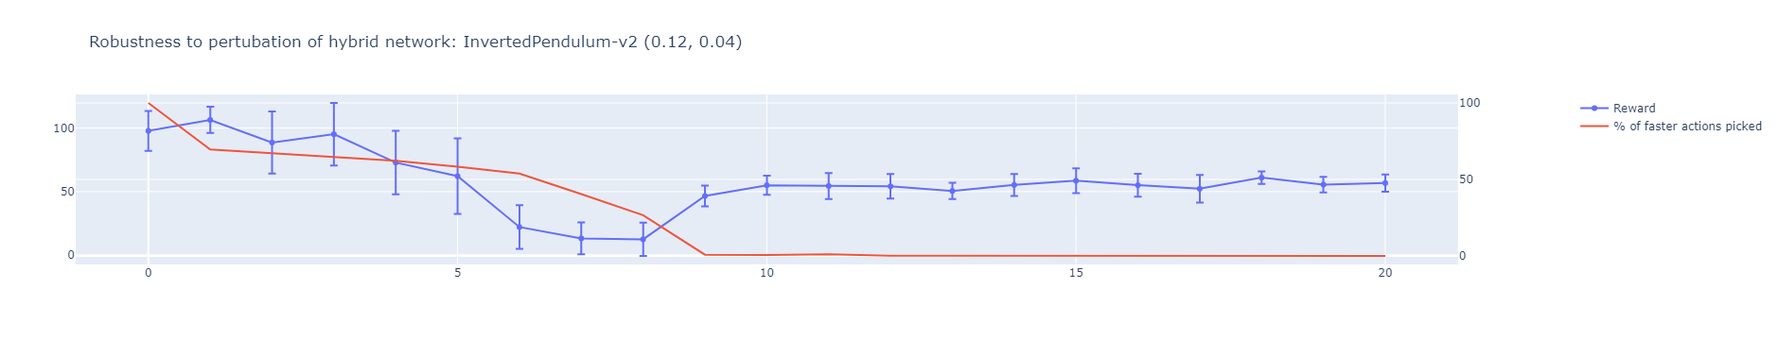
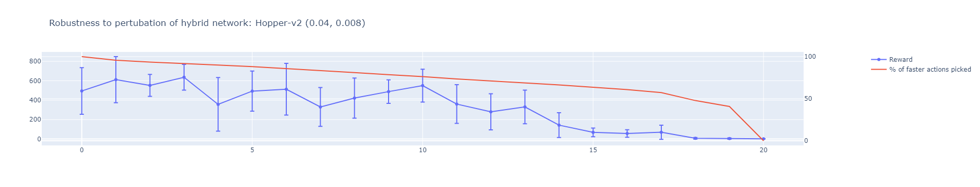

Slide 6
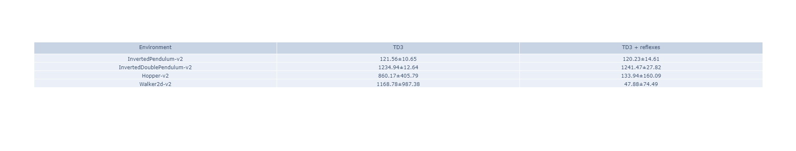
Previous attempt

Slide 7
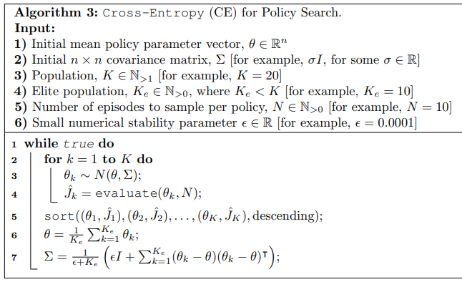
Reflex search using Cross-entropy
The reflex is parametrized as:
For each action dimension:
Θ₁: A threshold value for each input dimension
Θ₂: A scaling value that controls the intensity of the reflex action
Note that two neurons are required for a low and high threshold. However, the parameters can be reduced if the reflex is symmetric
Θ₁
Θ₂
Reflex parametrization

Slide 8
Hand designed reflexes present before training
Agent trained on top of the reflex
Run only for 400000 steps as opposed to million steps on benchmarks
The reflex response time is half of the normal response time

Slide 9
How to design reflexes for this?

Slide 10
Algorithm 1:
Train base network first
Train the fast (reflex) network:
Reward:
(-abs(TD) + reward) if next state for reflex is the next state for the base network
0 otherwise
s₁
s₂
Base network step
S_{1.5}
Method | Performance
Base network | 162.9
Reflex network (TD) | 155.21
Reflex network (reward) | 99.768
Reflex network (TD + reward) | 85.7
Reflex step
Reflex step

Slide 11
Algorithm 2:
Train base network first
Train the fast (reflex) network:
Reward:
(ΔTD + reward) at every step
s₁
s₂
Base network step
S_{1.5}
Method | Performance
Base network | 162.9
Reflex network (TD) | 155.61
Reflex network (reward) | 160.65
Reflex network (TD + reward) | 153.116
Reflex step
Reflex step
This is training a faster network on top of slower network normally

Slide 12
Algorithm 3:
Train base network first
Train the fast (reflex) network such that:
If TD > threshold, create an episode of length = 2 steps of the base network
s₁
s₂
Base network step
Reflex step
Reflex step
Reflex step
0
Method | Performance
Base network | 162.9
Reflex network (TD) | 146.64
Episode start
TD difference calculated wrt. Start of episode
TD > threshold noted
reward

Slide 13
Actor (slow A⁰)
Actor (Fast A¹)
TD⁰
TD¹
A⁰
+
A¹
Critic (slow)
Critic (Fast)
Compound action
State
reward
Environment
Action

Slide 14
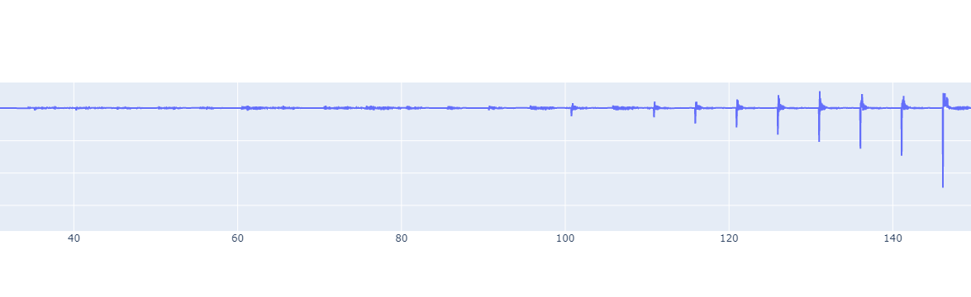
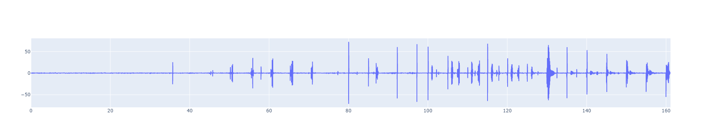
TD-Error on 0.04 network (trained on 8G)

Slide 15
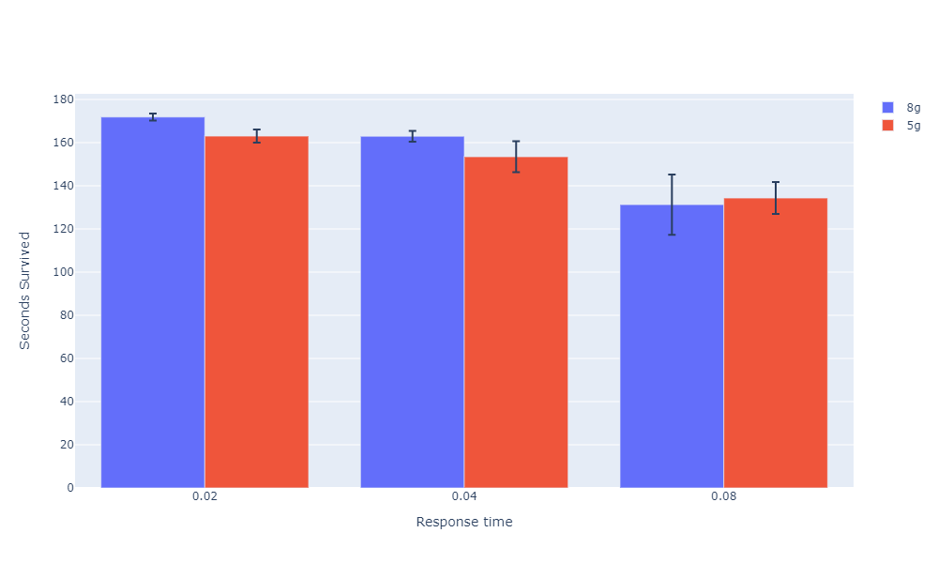
Averaged over 10 seeds and 10 episodes

Slide 16
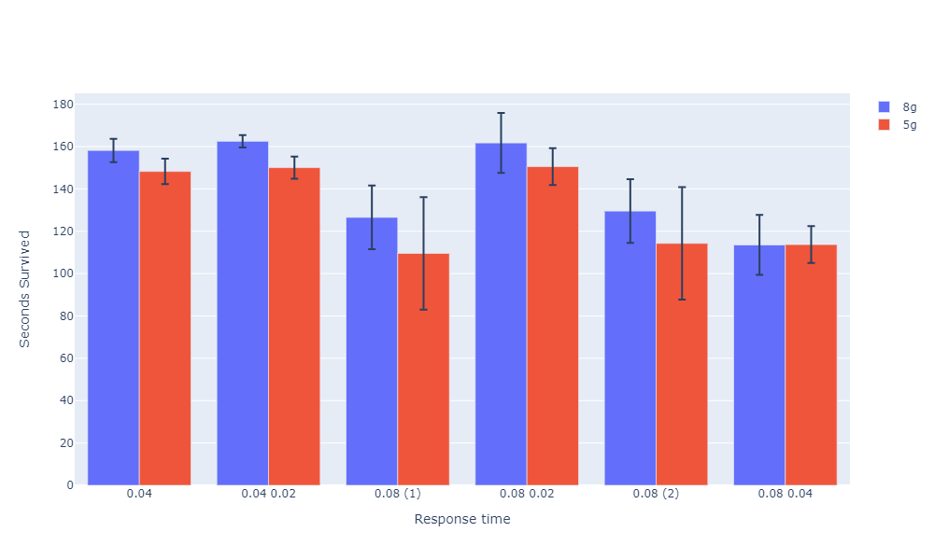
Averaged over 10 seeds and 10 episodes
Faster network trained normally over slower network

Slide 17
To check
Check few shot learning with reflexes
Transfer reflexes
Reflexes prevent negative rewards.
Add parent action and child action in state representation.
Slowly add reflexes on a trained network (while training it again).
Make parent network’s actions come in faster at dying states or states that have a drastic change in reward.

Slide 18
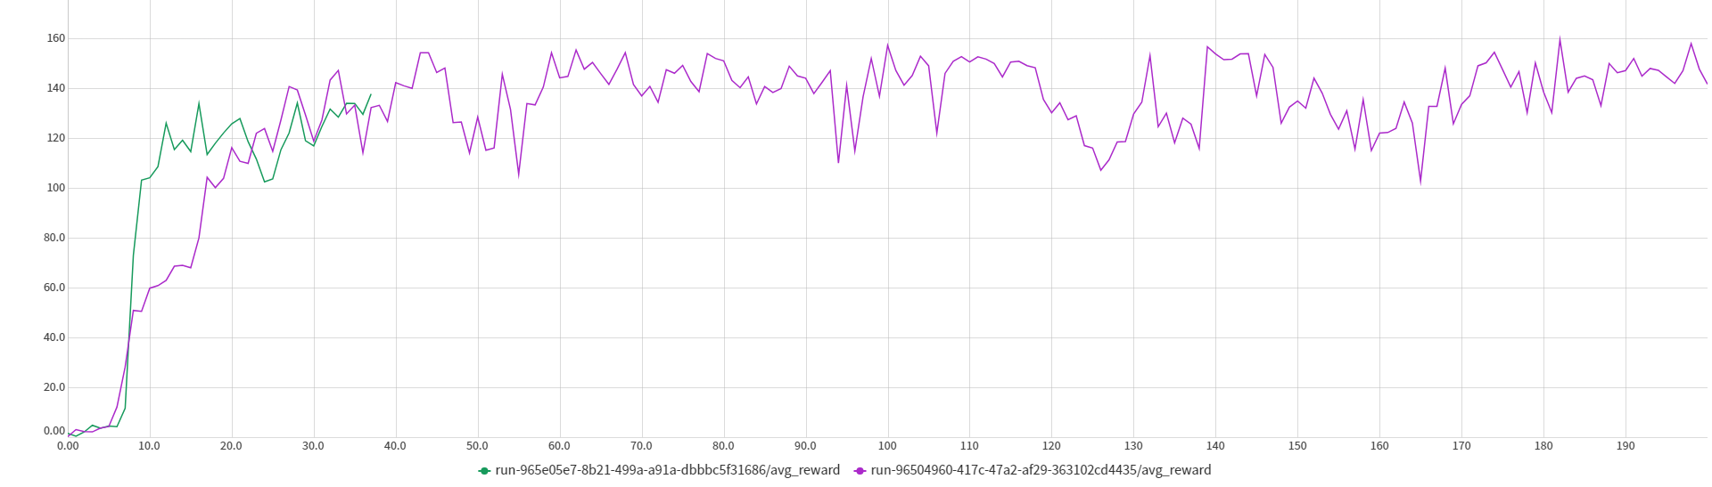
Approach on edge cases
Train a neural network on states that result on failure on the Teacher network.
Pick the same action but faster.
Neural network: 6 hidden neurons

Slide 19
Other summer works
DITTO
Submit to AAAI
Work on thesis proposal (due next sem)

Slide 20
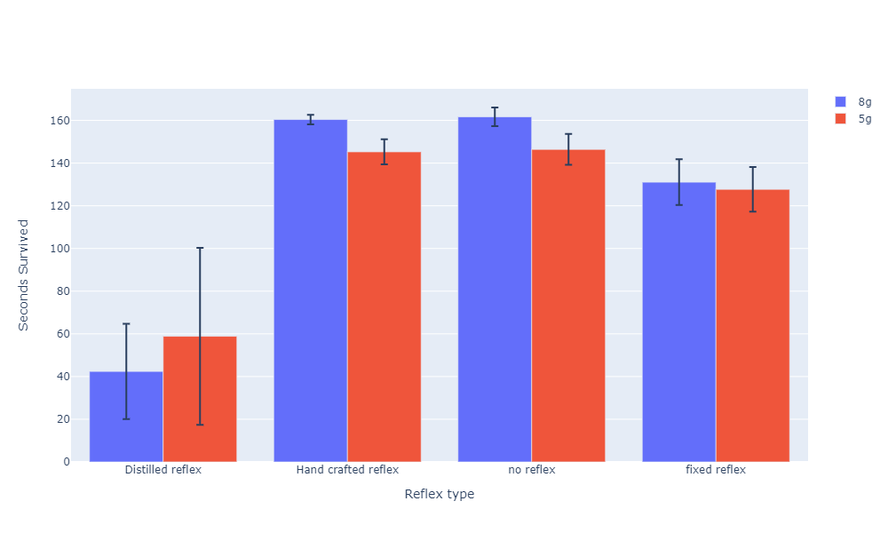
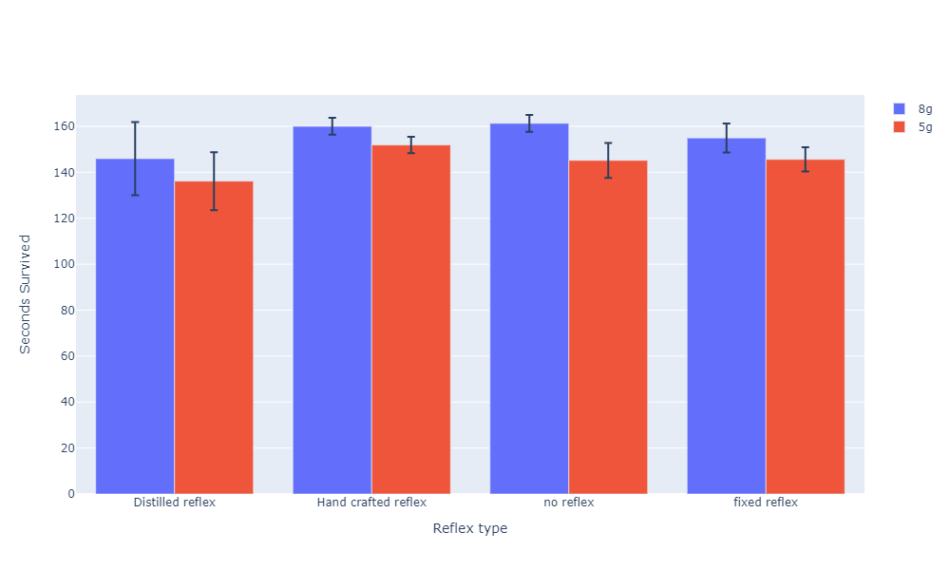
Reflex added after training
Reflex added before training

Slide 21
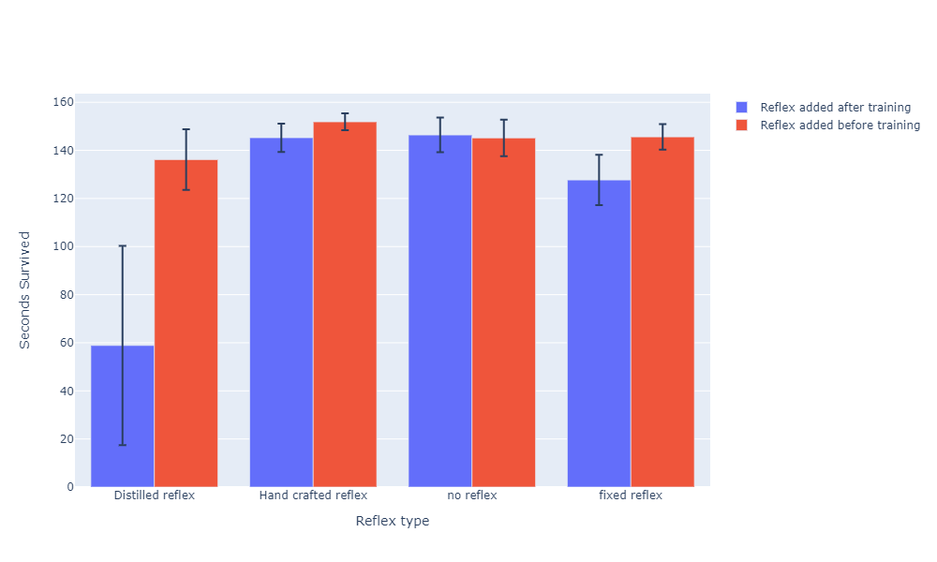
Averaged over 10 seeds and 10 episodes
5g pertubation

Slide 22
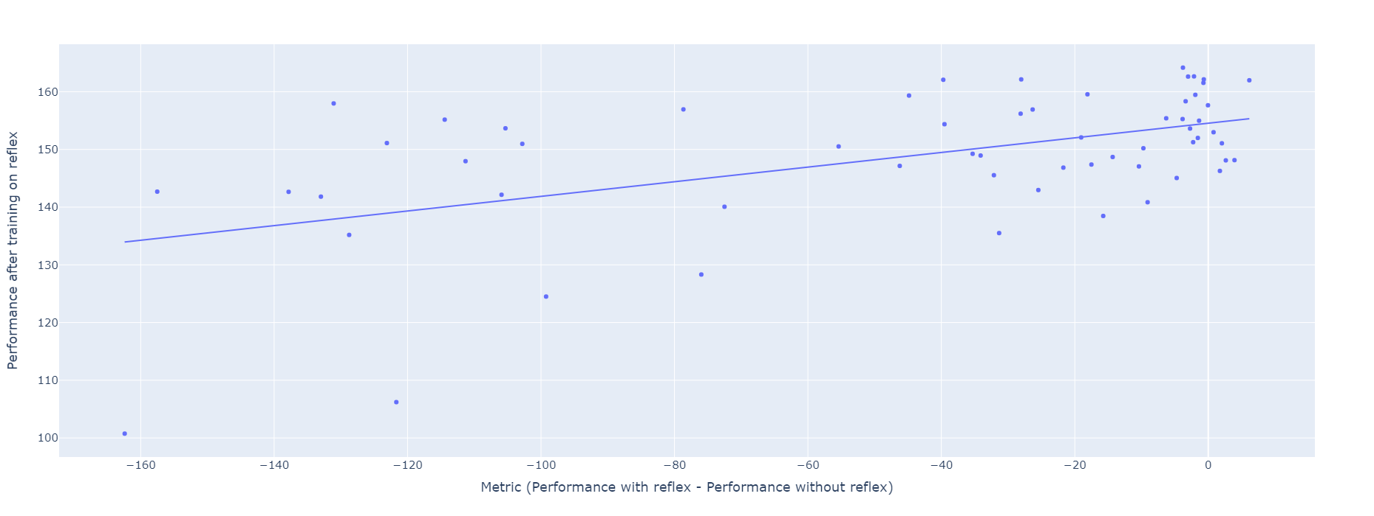
Perturbation: 5g
Reflex types: distillation, hand crafted, distillation (low error)
Seeds: 10
Each dot is avg. over 10 episodes

Slide 23
Reward = 0.12 * metric + 154.53
Not very strong correlation. Might be better if seeds are also averaged.

Slide 24
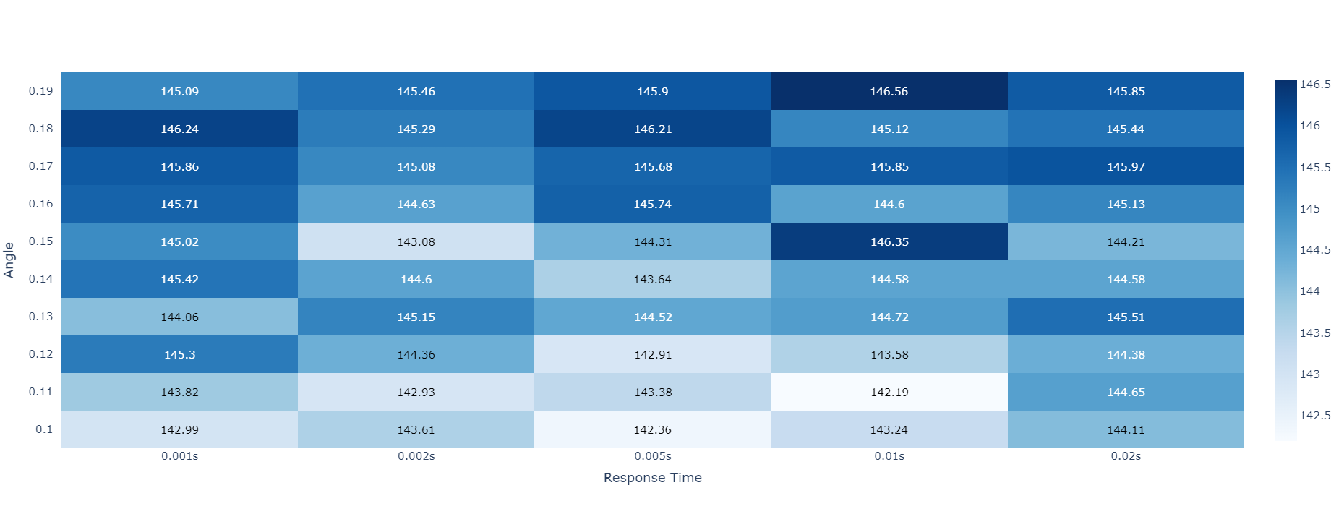
Manually searching for reflex using the metric
Not promising. The performance does not vary a lot.
Should try for 80ms response times.

Slide 25
Reflex search using Cross-entropy
The reflex is parametrized as:
For each action dimension:
Θ₁: A threshold value for each input dimension
Θ₂: A scaling value that controls the intensity of the reflex action
Note that two neurons are required for a low and high threshold. However, the parameters can be reduced if the reflex is symmetric
Θ₁
Θ₂
Reflex parametrization

Slide 26
Same robustness performance with 70% of the actions picked.

Slide 27
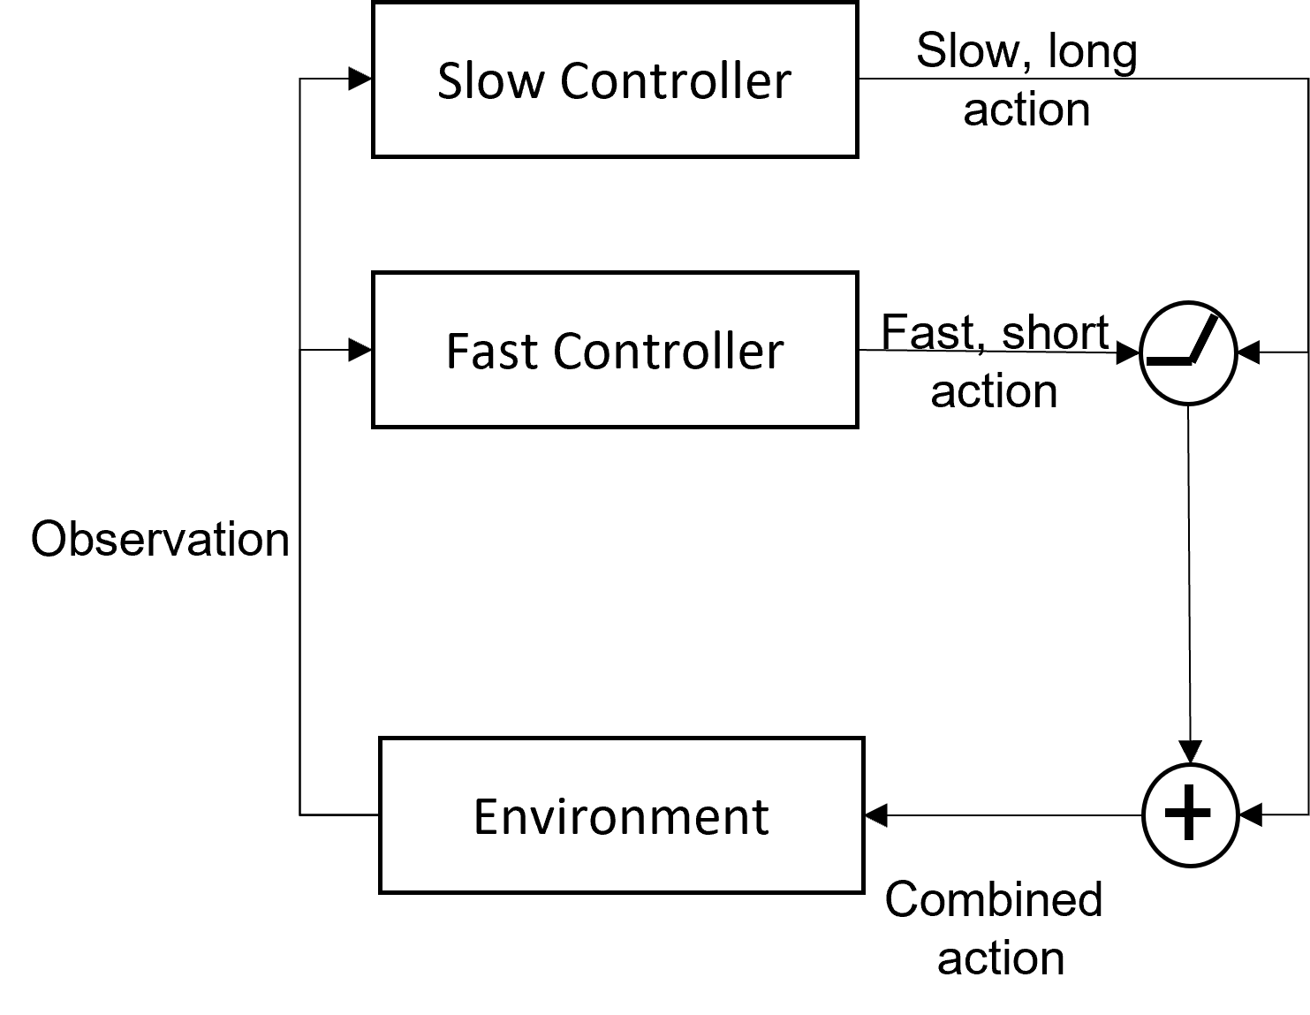
Slow Controller
Slow, Long Action
Fast Controller
Short, Fast
Action
Gate
Observation
Environment
Combined
Action

Slide 28
Separate Systems
Environment | TLA |  | TLA (oblivious slow network)
 | Return | RPA | Return | RPA
InvertedPendulum-v2 | 1000.00±0.0 | 1.96 | 1000.00±0.0 | 1.99
InvertedDoublePendulum-v2 | 9178.39±404.38 | 18.58 | 9170.52±407.33 | 10.74
Hopper-v2 | 3443.21±131.61 | 3.74 | 3448.76±84.18 | 3.93
Walker2d-v2 | 3694.04±128.58 | 3.96 | 2972.13±793.65 | 3.48

Slide 29
With Slow Action
Initial Fast action
F
F
F
F
Environment
S
S
Initial Slow action
TIME

Slide 30
With Oblivious Slow Network
Initial Fast action
F
F
F
F
Environment
S
S
Initial Slow action
TIME

Slide 31
Without Slow Action
Initial Fast action
F
F
F
F
Environment
S
S
Initial Slow action
TIME

